Slide 1

10 Things I Do In Every .NET App
scottsauber
Slides at scottsauber.com

Slide 2
Audience
.NET Developers
Interested in more maintainable apps
Hopefully that Venn Diagram is pretty much just a circle

Slide 3
Agenda
Series of lightning talks
Better folder structure
Treat Warnings As Errors
Logging “Best Practices”
Global Authorize Attribute via FallbackPolicy
Remove Server Header
Don’t use IOptions… use this one weird trick instead…👀
Version endpoint
Code Smells
HTTP Security Headers
Build Once, Deploy Many Times

Slide 4
Goals
Exposure to new ideas
Takeaway some ideas back to work

Slide 5



Who am I?
Director of Engineering at Lean TECHniques
Co-organizer of Iowa .NET User Group
Microsoft MVP
Friend of Redgate
Blog at scottsauber.com

Slide 6

Folder Structure

Slide 7
Problem: OOB MVC Folders By Responsibility
All of these live in their own separate folders and most are required to add a new feature
Controllers
Views
Models
wwwroot/css
wwwroot/js
Adds navigation friction
Scope of a feature is scattered
Makes it hard to add, delete or extend existing features

Slide 8
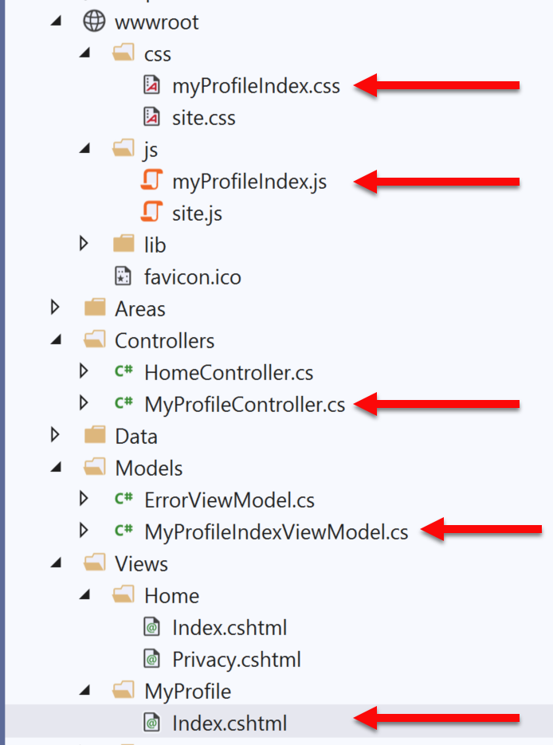
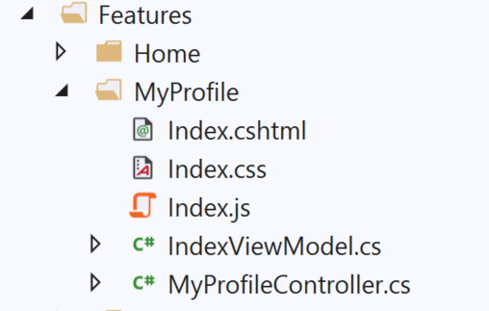
Solution: Use Feature Folders
Grouping by Feature, not by Responsibility, results in easier maintenance
Related things remain together (High Cohesion)
MVC out of the box:
Feature Folders:

Slide 9
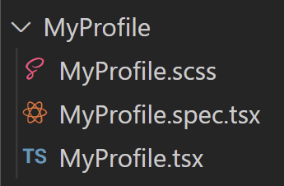
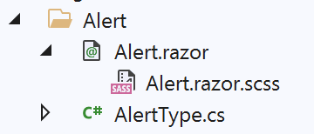

Solution: Use Feature Folders
React:
Blazor:
scottsauber
Notes:
Some even put tests in their feature folders

Slide 10
But mah layers!!!1one
I used to do horizontal csproj’s
.Data, .Business, .Common, .Models, .API
Now I just do two projects
.Core and .API (or .Web or .Console or whatever entrypoint is)
I slice the folders here vertically too

Slide 11
Feature Folder Extra Resources
Soap analogy
How to do this in ASP.NET Core
My blog post
Steve Smith’s Blog on Feature Folders vs. Areas
Refactoring to Vertical Slice architecture (featureFolders++)
Derek Comartin
scottsauber

Slide 12
Questions?

Slide 13

⚠️ == ❌

Slide 14
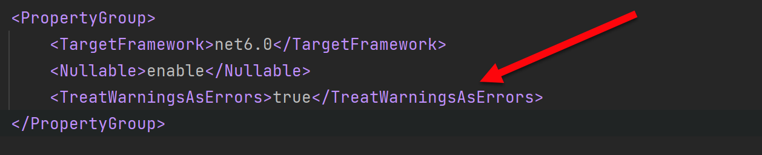
Treat Warnings as Errors
Build/Compiler warnings don’t exist in my world
Error or Nothing
scottsauber

Slide 15
Questions?

Slide 16

Logging “Best Practices”

Slide 17
Logging “Best Practices”
Use Serilog as logging framework
Use ILogger everywhere, not Serilog directly
Use structured logging, not concatenation
Each log should have key bits of information on it
User, Correlation ID, Request URL, App Version, etc.
“We need to log that”
Logs vs Metrics vs Audits

Slide 18
Logs
Developer focused
Example: log an exception or log response from external API
Log Levels
Debug vs Information vs Warning vs Error vs Critical
How long does my log store keep logs?
How reliable is my log delivery system
It’s okay to not have 100% guaranteed delivery of logs
How does Serilog work?

Slide 19
Metrics
Two types
Application
CPU, Network, Response Times, Queue Depth, etc.
Business
How many times did someone click that button
How long do we need to keep Metric data?
It may or may not be acceptable to miss some data
What data store are we using?

Slide 20
Audits
Recording who, did what, and when in your application
Usually for legal, compliance, or traceability reasons
Losing any data is unacceptable
Store audits with the same data store as the data that’s being audited

Slide 21
Questions?

Slide 22

Global Authorize Attribute via FallbackPolicy

Slide 23
Problem: Security is Opt-In
You have to remember to add a [Authorize] attribute everywhere
Or you have to remember to inherit from a custom BaseController
You forget? Oops you’re wide open to the world!

Slide 24
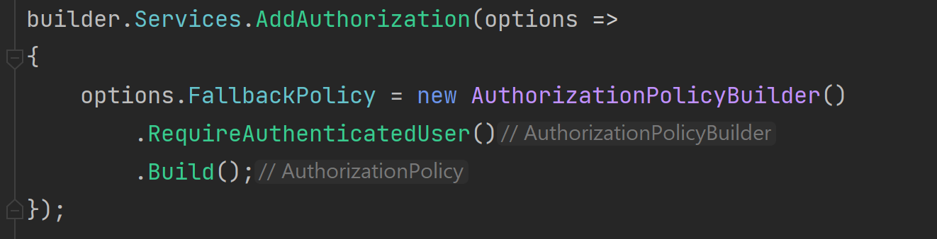
Solution: FallbackPolicy
A Fallback Policy is the policy that gets evaluated if no other policy is specified

Slide 25
Questions?

Slide 26

Remove the Server Header

Slide 27
Remove the Server Header
By default ASP.NET Core adds a “Server Header”
This says “Kestrel”
This exposes to black hats what you’re running
Focuses exploiting known CVEs

Slide 28
Questions?

Slide 29

Don’t use IOptions…

Slide 30
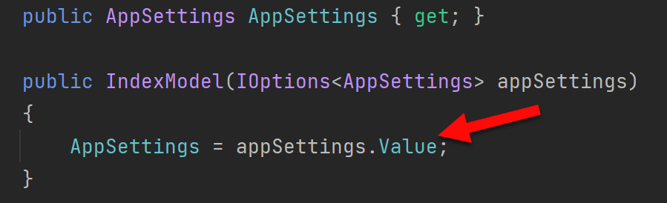
Problem: IOptions is annoying
Dependency on Microsoft.Extensions.Options down in other csproj’s
Testing IOptions is slightly annoying with Options.Create()
.Value everywhere adds friction
scottsauber

Slide 31
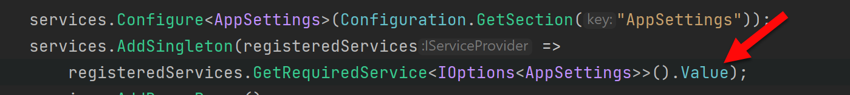
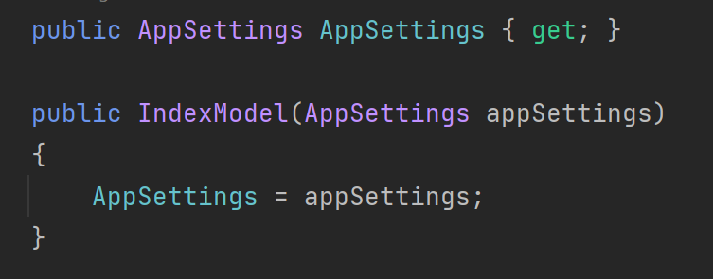
Solution: Register your Options class directly
scottsauber

Slide 32
Questions?

Slide 33

Version Endpoint

Slide 34
Version Endpoint
Versioning the API, right? Nope!
What version of your app are you running?
/api/version
Format:
<Date>.<BuildNumber>.<ShortGitSha>
20230617.1000.abc1234
Generate version in CI and store in a file read by endpoint, why a file?
Version goes on every log
Bonus: notify SPA of new deployment for reload purposes
scottsauber

Slide 35
Questions?

Slide 36
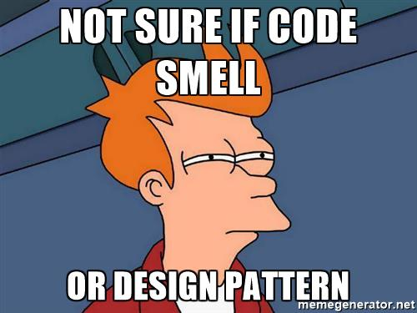
Code Smells

Slide 37
Structuring a method
Happy Path always at the bottom of the method
Don’t want to scan for “what happens when all goes well” and find it in the middle of a method
Use return’s instead of nested if => else
scottsauber

Slide 38
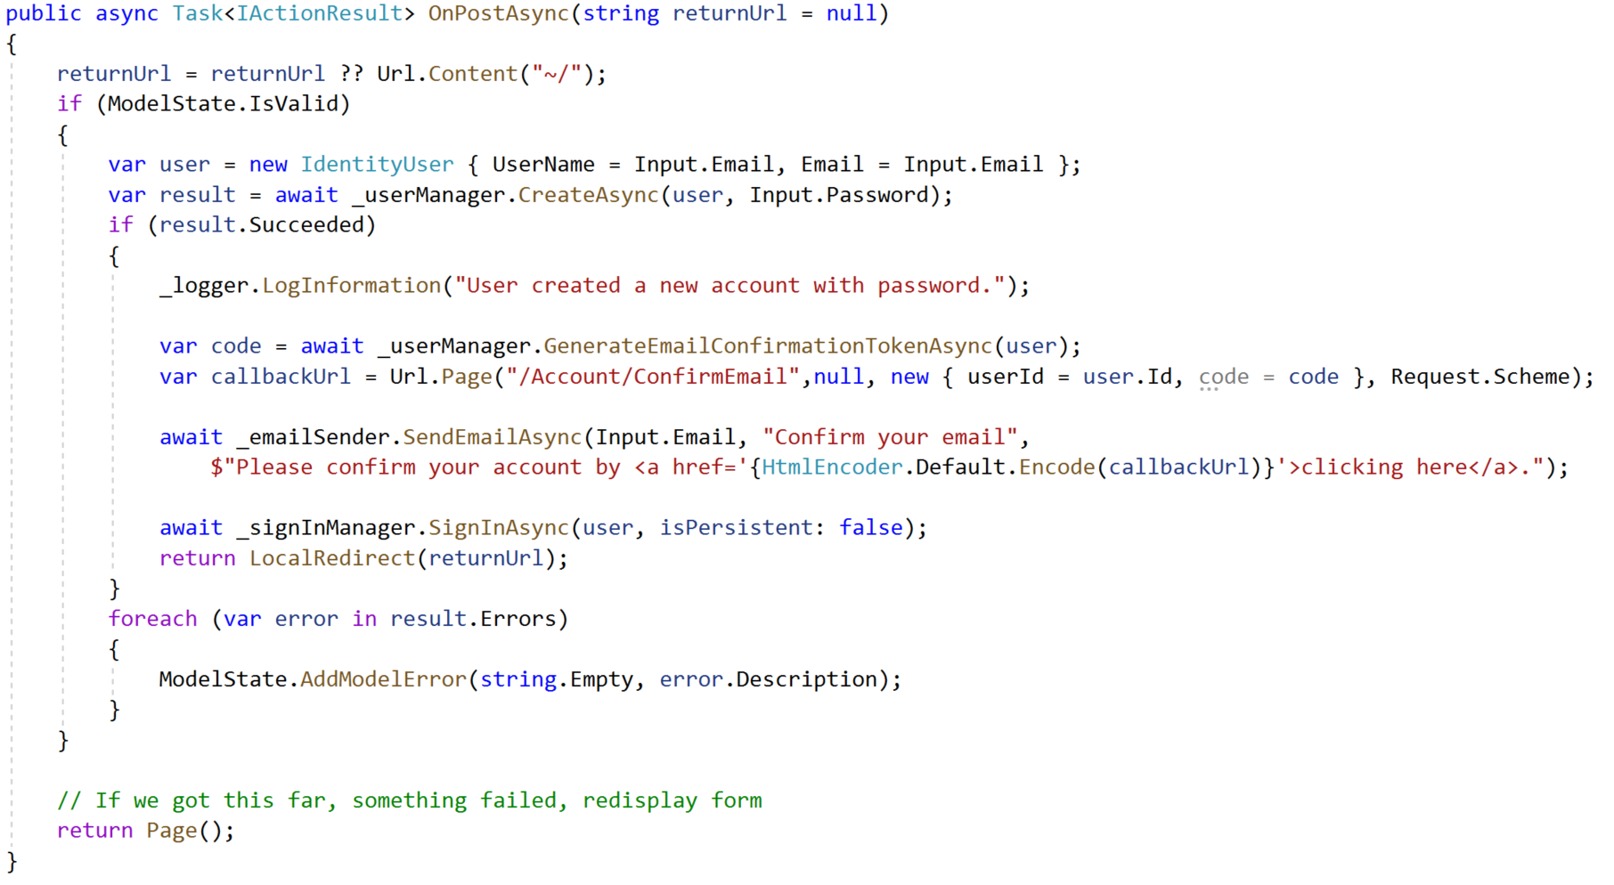
Razor Pages Template Code:

Slide 39
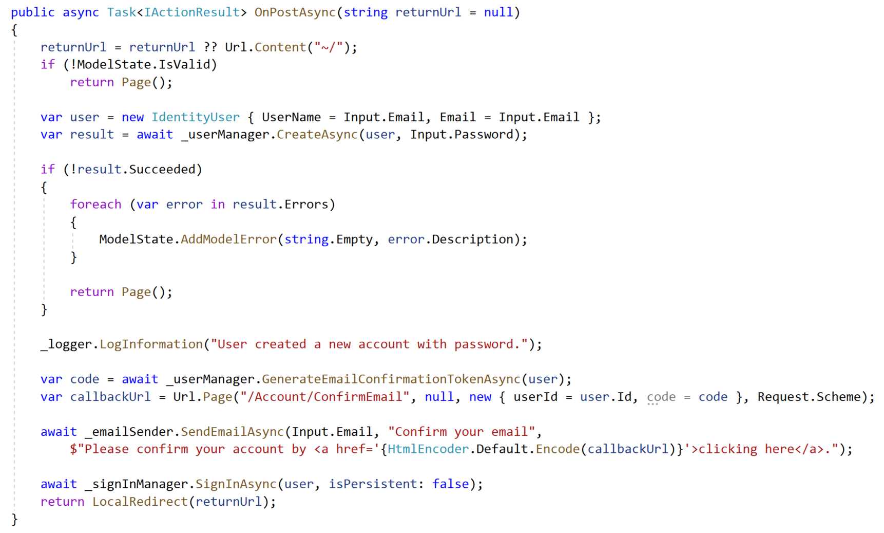
Refactored with Happy Path At The Bottom:

Slide 40
The Indentation Proclamation
The more indented your code is, the harder it is to follow
Nested if’s, nested loops, etc.
…I made this up
scottsauber

Slide 41

Code smells
Not hard and fast rules, just my “warning light”
Methods > 20 lines
Classes > 200 lines
Regions
You probably should’ve added a new class or method instead

Slide 42
Questions?

Slide 43
HTTP Security Headers

Slide 44
HTTP Security Headers
Tells a browser what extra rules to enforce
Protects against MITM, clickjacking, cross-site scripting, and more
Be careful!
NetEscapades.AspNetCore.SecurityHeaders

Slide 45
Resources
My talk deep diving on this topic: https://www.youtube.com/watch?v=7MWXTXjtl8s

Slide 46
Questions?

Slide 47

Build Once, Deploy Many Times

Slide 48
Build Once, Deploy Many Times
Discourages Long Running Branches and GitFlow
Encourages Trunk Based Development (even with PRs)
Encourages Continuous Integration (the practice)
Easier testing
Environmental differences (i.e. config, secrets) live in the environment

Slide 49
Questions?

Slide 50
Bonus!
CI/CD Pipelines
Write tests
Work in small batches
Deploy frequently (should be daily or more frequent)
Don’t put your Infrastructure as Code in another repo

Slide 51
Real benefits of these practices
1 web app went from deploying to Prod 12x a year to 1000x a year
Faster, more reliable delivery of value to users

Slide 52
Questions? Contact: ssauber@leantechniques.com
Slides at scottsauber.com
scottsauber

Slide 53
Thanks!
Slides at scottsauber.com
scottsauber

